Slide 1
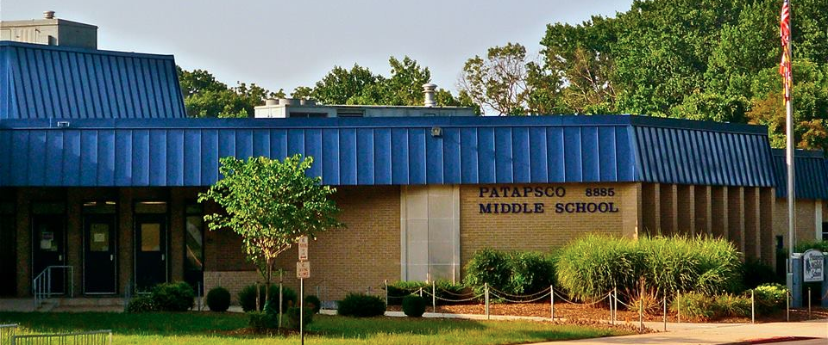

Welcome to Patapsco!
Building a Strong Foundation for High School and Beyond
Notes:
mike

Slide 2
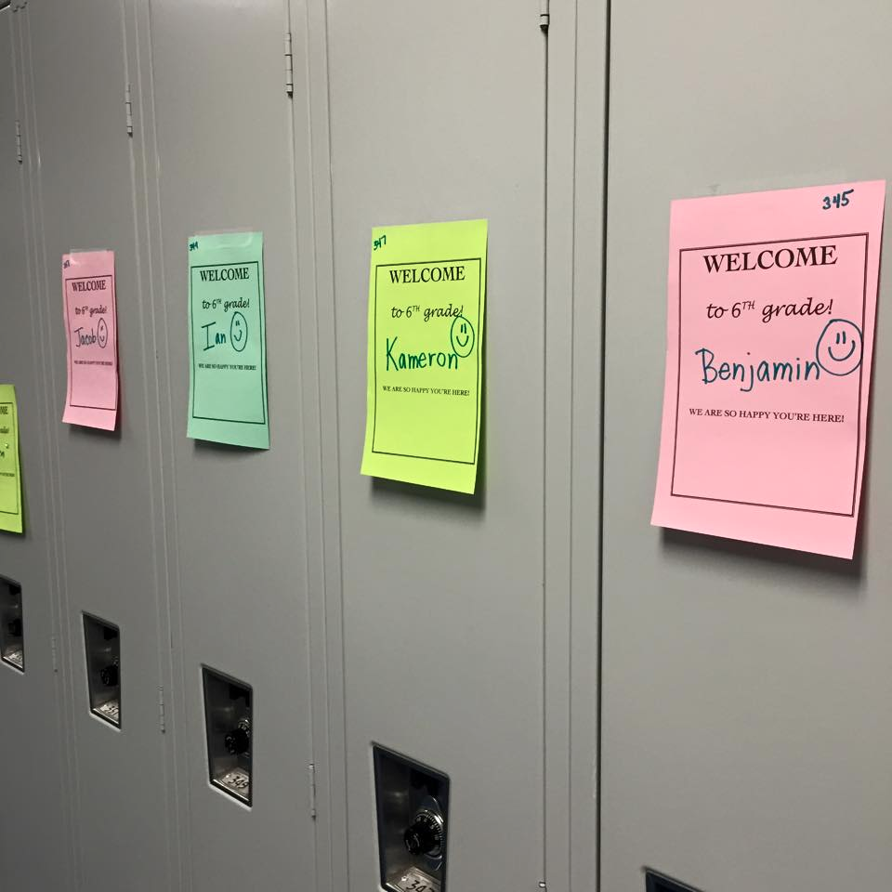
Agenda
Middle School Requirements
Scheduling Options
GT Programs
Easing into Middle School
Notes:
mike

Slide 3

At Patapsco We Are:
#OnePatapsco
A place where everyone is VALUED and IMPORTANT
Notes:
mike

Slide 4
The level of academic achievement that students attain by eighth grade has a larger impact on their college and career readiness than anything that happens academically in high school.
Source: The Forgotten Middle: Ensuring that All Students Are On Target For College and Career Readiness Before High School
Notes:
mike- edit

Slide 5
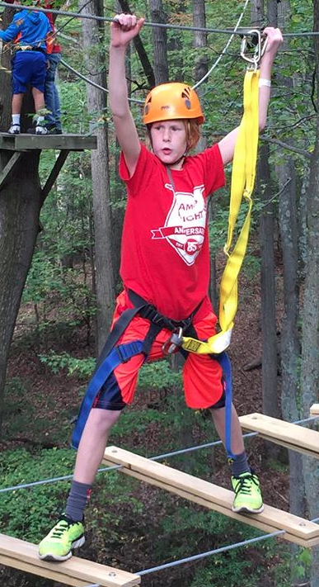
STRIKING A BALANCE
Course Placements
Rigor
Personal Interests
Student Success
Their Future v. Our Present
Notes:
Kendra
Strike a balance between school and activities -
Consider the increase in academic demands as you register for activities outside of school
Middle School students will have anywhere from 1-2 hours of homework per night (depending on level, number, and type of courses)
Reading is encouraged (2.5 hrs/week)
Encouraging organization now is critical
Start thinking about which commitments your student will engage in and whether you need to scale back

Slide 6
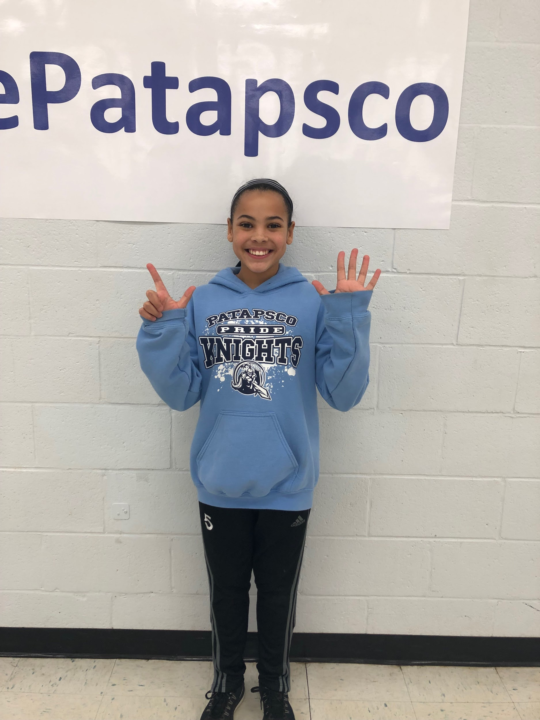
All students are enrolled in seven
50-minute classes every day
Notes:
Kendra

Slide 7
In Middle School ALL Students must take:
English
Mathematics
Social Studies
Science
Aligned to Maryland’s College & Career-Ready Standards
Notes:
Kendra
English, mathematics, science, and social studies.

Slide 8
In Middle School ALL Students must take:
Health Education*
Physical Education*
Careers
Fine Arts*
(General Music and /or Art)
*Requirement by Code of Maryland Regulations
Notes:
Kendra
In addition Maryland regulations require all students to take Health Education, Physical Education, and a Fine Arts (Art and/or Music) course every year. In 6th grade, students are also required to participate in a careers until.

Slide 9
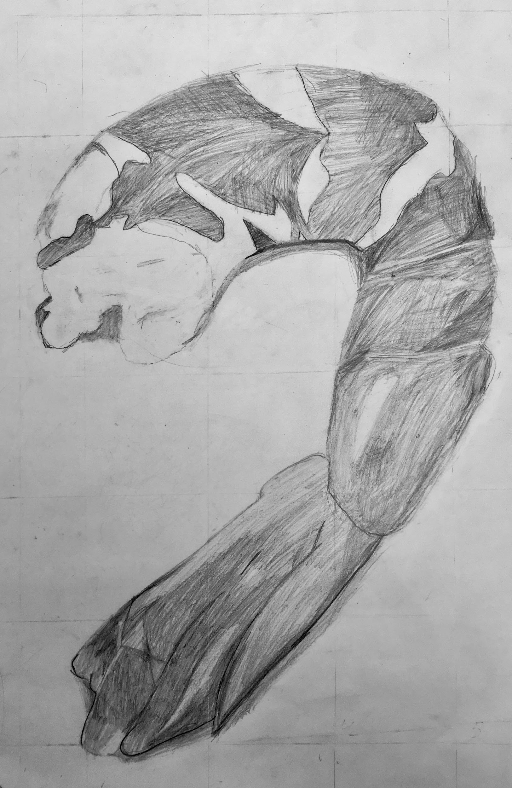
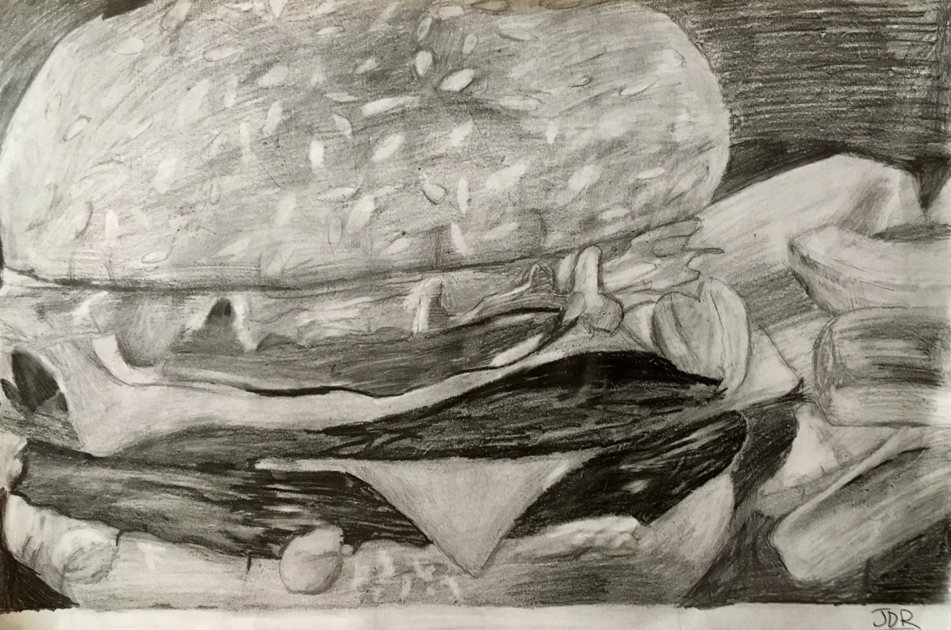
Students May Take...
Family and Consumer Science* (FACS)
Technology Education
Reading and/or Math Intervention**
GT Research
*COMAR requirements for Financial Literacy met through course objectives in this subject.
**Required for some students
Notes:
SCHEDULING NOTES:
Students who are reading on or below grade level will take at least two quarters of reading in 6th grade, one of which will be a reading skills transitional module, unless the students are enrolled in a reading seminar.

Slide 10
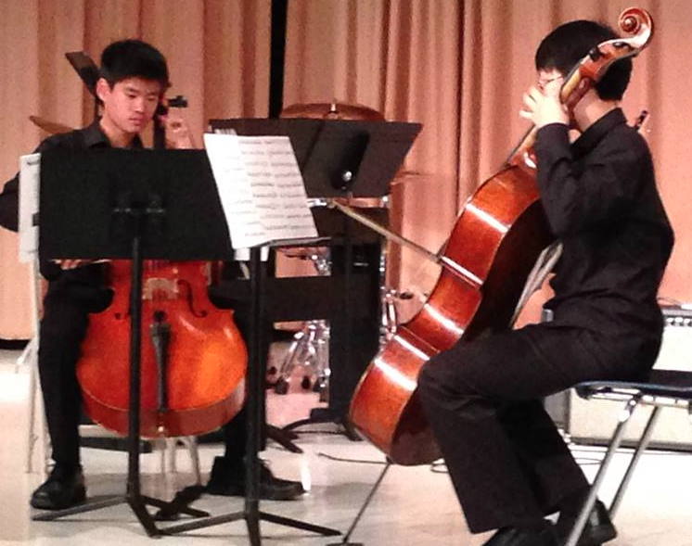
OPTIONS:
Performance Ensembles
Band – Chorus – Orchestra
Year-long class
50 minute daily ensemble rehearsal and 50 minute weekly sectional (B & O)
Ensembles are ability-based
Music teachers will contact elementary programs to schedule meetings & auditions
Notes:
Morgan - Sectionals occur weekly and take place during both academic and related arts classes. Students will need to have the ability to make-up work missed due to sectionals. Sectionals are not ‘optional’. Students must attend when the section is having their scheduled lesson. This is something that families need to discuss as the demand for performance and work ethic.
Sectionals are scheduled on a rotating basis to avoid students missing the same class regularly. When the director is able to, he attempts to ensure students miss each academic class no more often than two times per quarter.

Slide 11
Who decides the options?
Students may be recommended to take a reading/math instructional seminar.
Students eligible for GT Research course can elect to take it in place of RA (semester long A/B day).
Performance Ensembles are family choice.
Related Arts and Reading Modules are assigned, not selected.
Some choices are limited by scheduling needs and availability of seats.

Slide 12
BASIC SCHEDULE
Time | Pd | 6th Grade
8:05 – 8:13 | HR | Homeroom
8:15 – 9:05 | 1 | Related Arts (A/B Day)
9:07- 9:57 | 2 | Related Arts (A/B Day)
9:59 – 10:49 | 3 | Academic/Seminar
10:51 – 11:41 | 4 | Academic/Seminar
11:43- 12:34 | 5 | Academic/Seminar
12:36 – 1:06 |  | Lunch
1:08 – 1:58 | 6 | Academic/Seminar
2:00 – 2:50 | 7 | Academic/Seminar
Notes:
Morgan & Kendra

Slide 13
How It All Fits!
OVERVIEW:
Every student has 7 fifty-minute classes each day

Slide 14
Patapsco MS Schedule
OVERVIEW:
EVERY student receives daily instruction in:
English Language Arts (ELA)
Mathematics
Social Studies
Science

Slide 15
BASIC SCHEDULE
Time | Pd | 6th Grade
8:05 – 8:13 | HR | Homeroom
8:15 – 9:05 | 1 | Related Arts (A/B Day)
9:07- 9:57 | 2 | Related Arts (A/B Day)
9:59 – 10:49 | 3 | Academic/Seminar
10:51 – 11:41 | 4 | Academic/Seminar
11:43- 12:34 | 5 | Academic/Seminar
12:36 – 1:06 |  | Lunch
1:08 – 1:58 | 6 | Academic/Seminar
2:00 – 2:50 | 7 | Academic/Seminar
✅
✅
✅
✅
Notes:
Morgan & Kendra

Slide 16
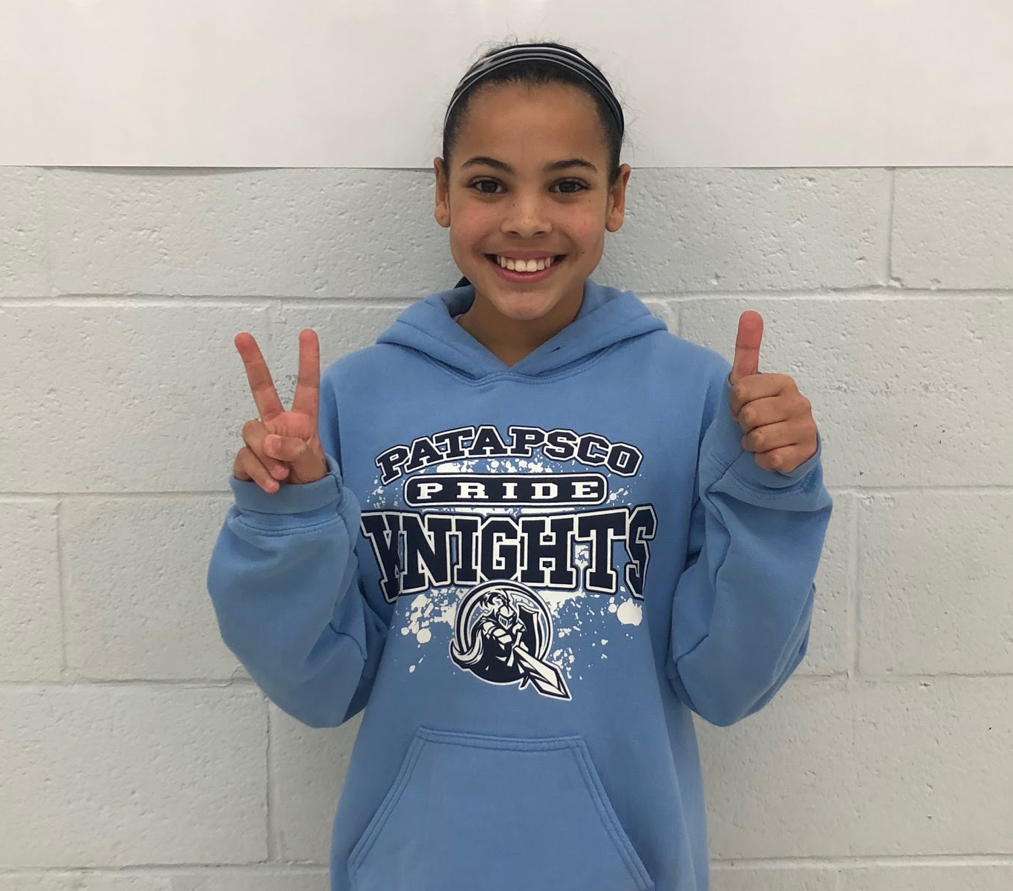
Patapsco MS Schedule
OVERVIEW:
Take away those 4 common classes, and each student has:
3 classes left per day

Slide 17
Patapsco MS Schedule
OVERVIEW:
Every student has 2 related arts blocks per day which could
include:
PE
Health
Art
General Music
FACS
Tech Ed
Careers
GT Research
Math Seminar

Slide 18
BASIC SCHEDULE
Time | Pd | 6th Grade
8:05 – 8:13 | HR | Homeroom
8:15 – 9:05 | 1 | Related Arts (A/B Day)
9:07- 9:57 | 2 | Related Arts (A/B Day)
9:59 – 10:49 | 3 | Academic/Seminar
10:51 – 11:41 | 4 | Academic/Seminar
11:43- 12:34 | 5 | Academic/Seminar
12:36 – 1:06 |  | Lunch
1:08 – 1:58 | 6 | Academic/Seminar
2:00 – 2:50 | 7 | Academic/Seminar
✅
✅
✅
✅
✅
✅
Notes:
Morgan & Kendra

Slide 19
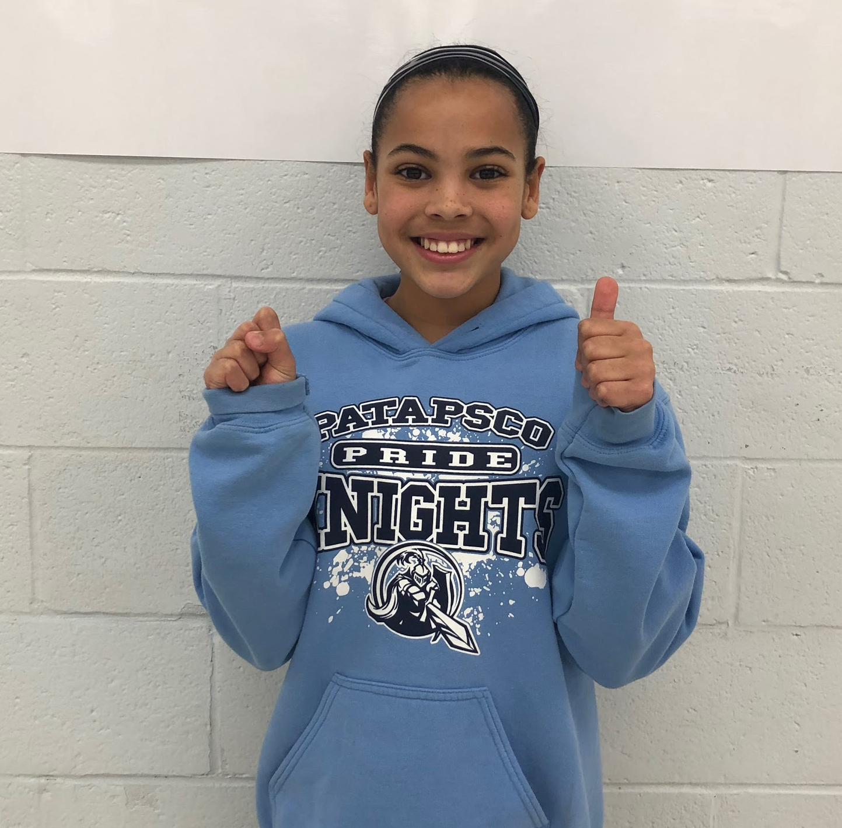
Patapsco MS Schedule
OVERVIEW:
Take away those 2 related arts blocks, and each student has:
1 class left per day

Slide 20
BASIC SCHEDULE
Time | Pd | 6th Grade
8:05 – 8:13 | HR | Homeroom
8:15 – 9:05 | 1 | Related Arts (A/B Day)
9:07- 9:57 | 2 | Related Arts (A/B Day)
9:59 – 10:49 | 3 | Academic/Seminar
10:51 – 11:41 | 4 | Academic/Seminar
11:43- 12:34 | 5 | Academic/Seminar
12:36 – 1:06 |  | Lunch
1:08 – 1:58 | 6 | Academic/Seminar
2:00 – 2:50 | 7 | Academic/Seminar
✅
✅
✅
✅
✅
✅
Notes:
Morgan & Kendra

Slide 21
Patapsco MS Schedule
OVERVIEW:
Students must take one of the following:
Innovation & Inquiry Reading Modules (full year)- default class
Instructional Intervention Seminars
for students performing below grade-level in reading
  Reading intervention seminar
  ELL support
Band
Orchestra
Chorus

Slide 22
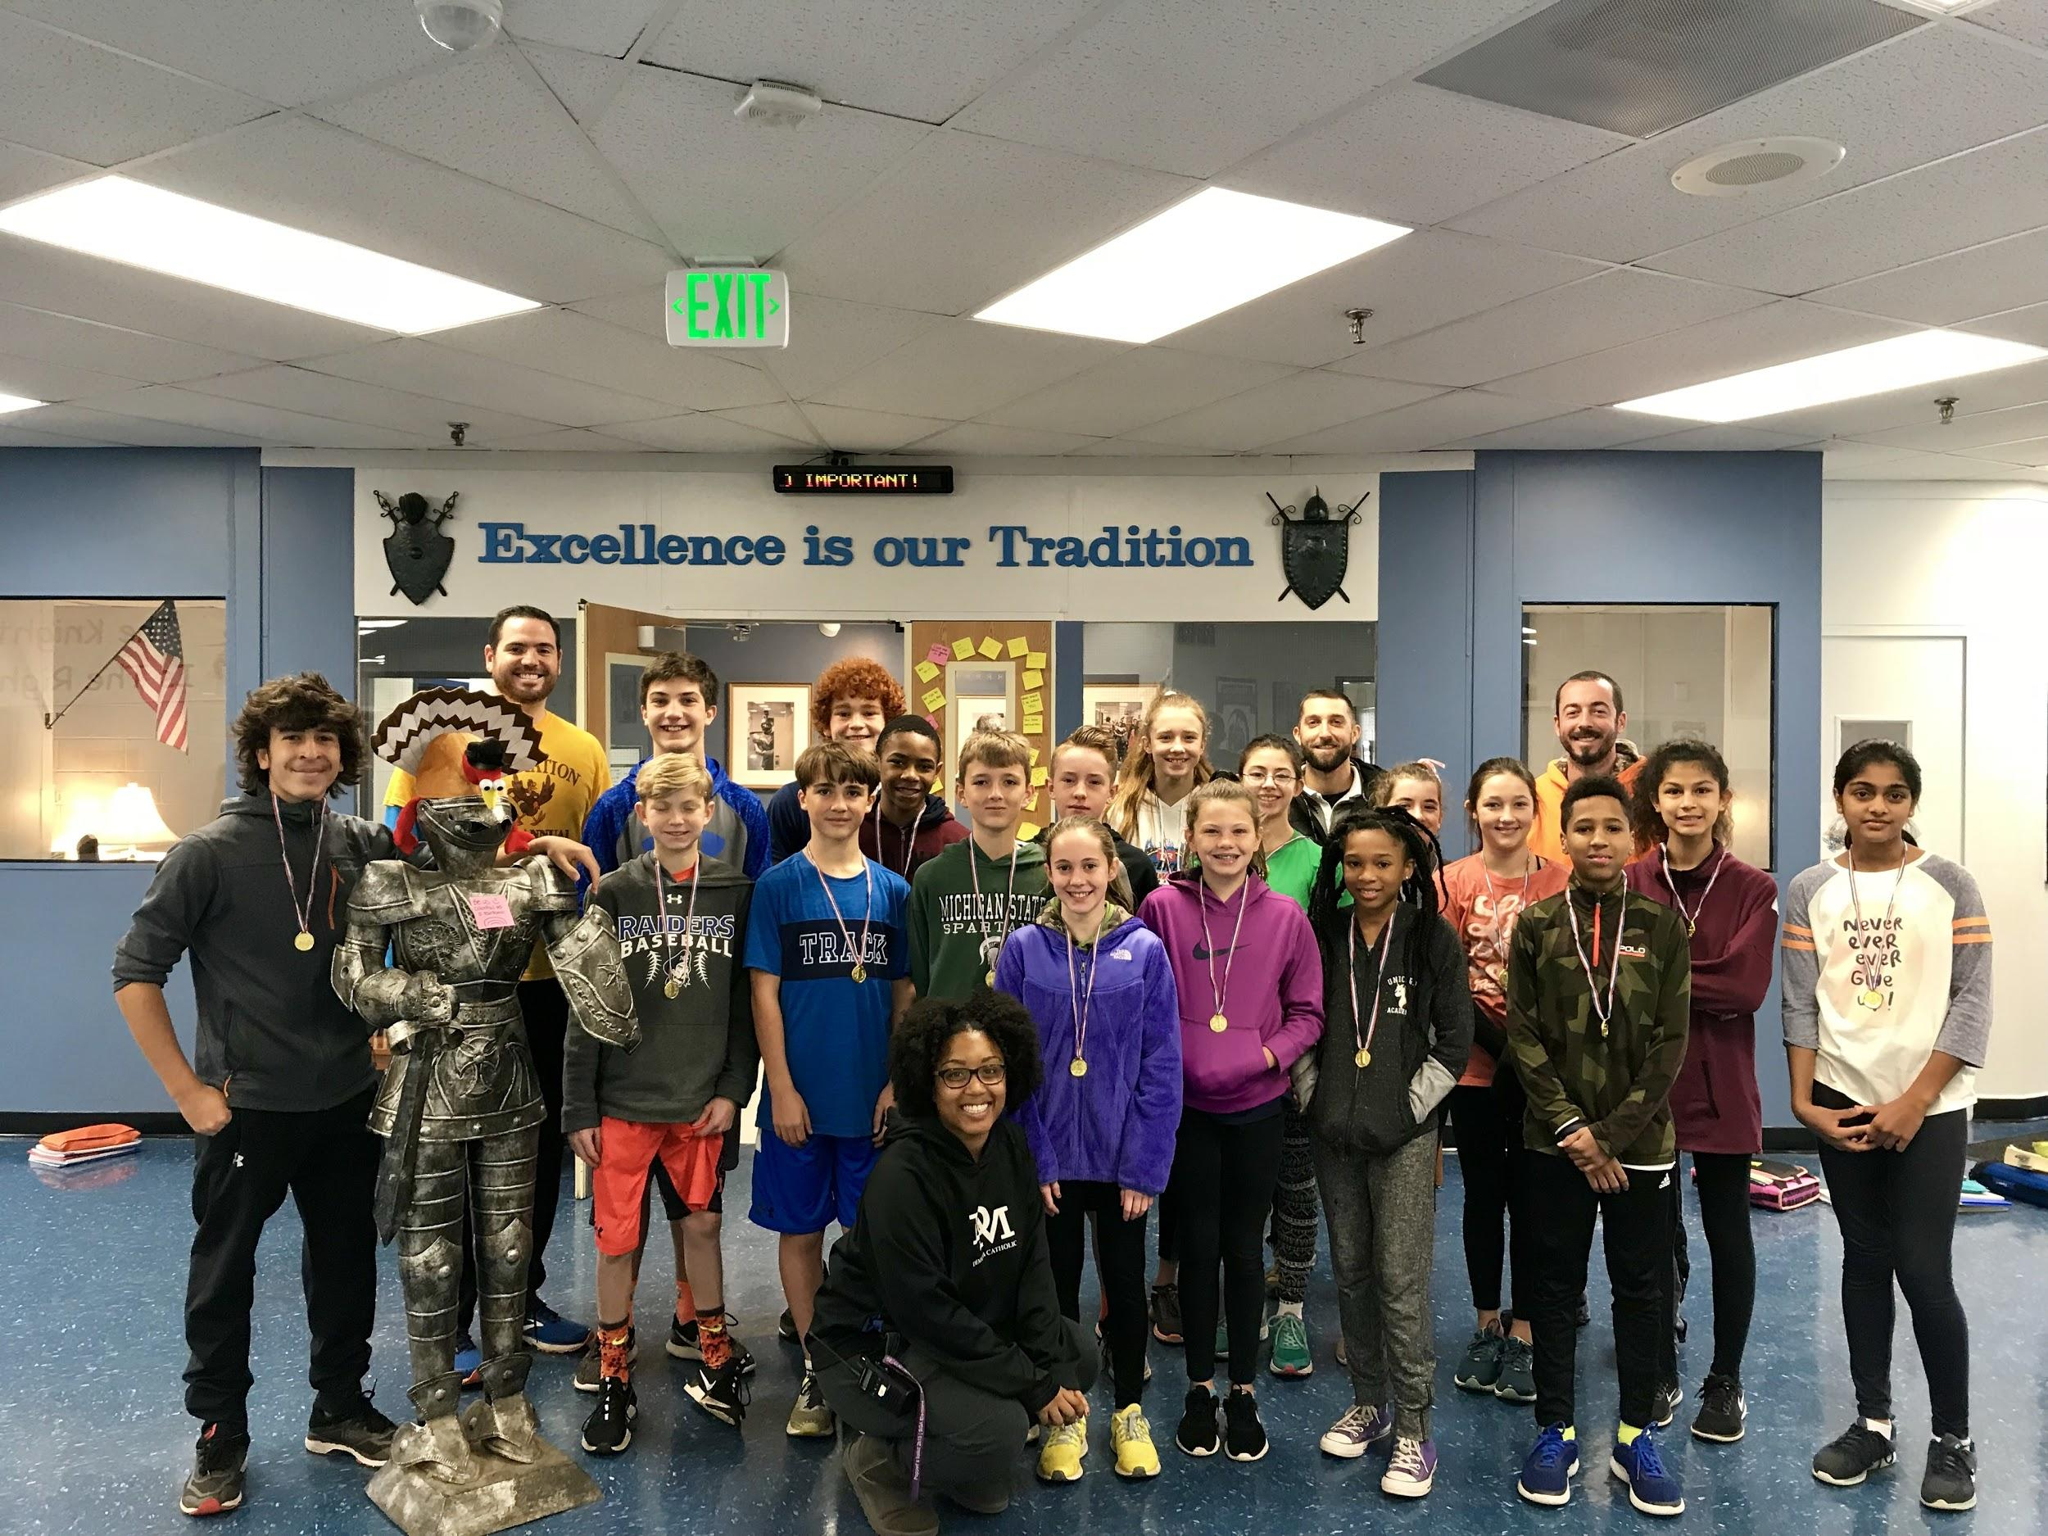
G/T (Gifted and Talented) Content Classes
Accelerated and/or Enriched Curriculum
Advanced-Level Content
Inquiry-Based Instruction
Application of Knowledge
Notes:
Sammi- G/T Content Area classes offer an accelerated and/or enriched curriculum and advanced-level content. Teachers focus on the application of knowledge through inquiry-based instruction.

Slide 23




Middle School G/T Classes
G/T Math
G/T Science
G/T English
G/T Social Studies
Notes:
Sammi- Placements in G/T classes are academic placements based on the needs of each individual child.
There are 4 G/T content area classes - Eligible students can choose to participate in one, two, three, or all 4 classes. The number of classes in which eligible students participate greatly depends on the individual child. While, it is very appropriate for some 6th graders to participate in all 4 classes of eligibility, it is also it is appropriate for other students to choose to participate in selected classes that are of the greatest interest. Eligibility to participate in a class extends to 8th grade.
Therefore, a child who may select to participate in G/T English and math in 6th grade, may choose to add G/T science as a 7th grader, if he or see was originally eligible.
Students who participate in G/T classes in middle school are expected to participate In high school G/T and Advanced Placement courses.

Slide 24
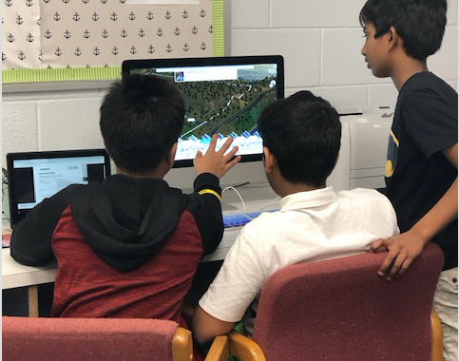
G/T Mathematics
Provides an accelerated and enriched sequence that follows a curriculum of concepts at least two years above the general education curriculum.
6 - Pre-Algebra G/T
7 - Algebra I G/T
8 - Geometry G/T
Notes:
Sammi- Grades for Algebra 1 and Geometry will be placed on the students official high school transcript and will be part of the transcript that eventually accompanies college applications. The grades however, will not be calculated into the students high school GPA.
NOTE: If asked about Accelerated Math, please refer all questions to the G/T Education Program Office at 410-313-6800.

Slide 25

G/T English
Extends the Maryland College and Career Ready Standards for English Language Arts through
an accelerated pace,
reading and analyzing challenging and complex literature and literary nonfiction independently,
writing a variety of interpretive,
and analytical pieces, and conducting independent research.
Differentiated tasks and texts are included at all grade levels.
Notes:
Sammi- Successful G/T English participants are avid readers and writers and have demonstrated an advanced-level ability in both areas. Participating students read advanced-level selections; therefore, they should all be above level readers. Differentiated texts are one of several ways that the G/T English curriculum is enriched and extended for advanced-level learners.

Slide 26

G/T Social Studies
Provides an enriched and accelerated curriculum, including differentiated objectives, where students explore civic and cultural principles and engage in inquiries that focus on essential, related questions.
6 - Geography and World Cultures G/T
7 - Geography and World Cultures G/T
8 - United States History G/T
Notes:
Sammi- Successful participants in G/T social studies are students who demonstrate a curiosity and interest in topics related to history, culture, and current events. These students demonstrate their interest in a variety of ways that may include asking insightful questions and/or grappling with issues during discussions of related topics.
In addition to the differentiated objectives, students who participate in G/T social studies complete inquiry tasks each year. One of these may be presented for feedback from professionals in a forum such as National History Day.
Participating students should be avid readers and writers with advanced-level skills in both areas.

Slide 27
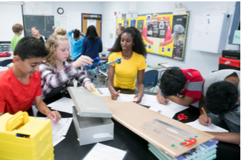
G/T Science
An enriched and accelerated curriculum where students explore cross-cutting concepts, as well as science and engineering practices.
6 - Earth Science G/T
7 - Life Science G/T
8- Physical Science G/T
Notes:
Sammi- Successful participants in G/T science are students who have an advanced-level background knowledge in scientific topics and ask insightful questions in scientific areas. Students do not have to be in G/T math or above-level math in order to participate in G/T Science.

Slide 28
Placement Process For Middle School G/T – 5th Grade
5th Grade
CogAT administered to ALL students in December.
All students reviewed as part of G/T Placement Process.
Feb.- GT Placement Committee decisions, including CogAT scores and GT Research Class letters, are mailed to parents of fifth grade students.
Notes:
Sammi- All students in HCPSS took the Cognitive Abilities Test (CogAT) in December of their 5th grade year. The CogAT is an ability measure (not an achievement test) that is used as an initial indicator of eligibility for G/T content area classes. If a student is not eligible based upon the CogAT scores, elementary teachers automatically reviewed the placement, using multiple performance criteria, such as other assessments and student work samples. Each elementary school team makes recommendations and communicates those in writing.
Students who are new to Howard County and did not take the CogAT in 5th grade, will be given The School and College Ability Test (SCAT) in order to determine initial eligibility for G/T content area classes. Test results will be communicated in writing.

Slide 29
Parental Input in Placement Process
If after reviewing the Placement Committee's professional recommendation, parents/guardians still wish to enroll their students in one or more G/T classes, they may complete the Course Placement Review form.

Slide 30
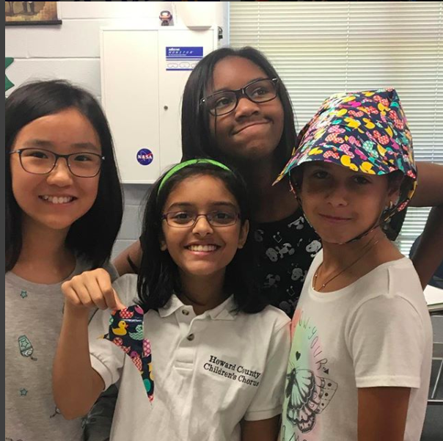
Who can initiate the placement process in middle school?
Families
Teachers
Students
Notes:
Sammi- Teachers are continuously assessing readiness for all students throughout middle school. In addition, once a student has been tested, parents, guardians, and or a student may request a review of a child’s placement by submitting a written request to the G/T Resource Teacher.

Slide 31
Measures Included in Placement Process
Ability Measure (CogAT or SCAT)
Standardized assessments (MAP, PARCC)
Student work samples
  Interpretation
  Critique
  Analysis
  Creative Problem Solving
Student grades on assignments requiring critical, analytical, and/or creative thinking
Documentation from families
Notes:
Sammi- A placement review team that consists of content area teachers, an administrator, and the Gifted and Talented Resource Teacher will review the multiple sources of data for your child and will communicate the placement decision to you in writing.
Parents and or guardians may provide additional information and work samples to the school to be considered in the review process.

Slide 32

Middle School GT Research Class
Authentic research to address real-world problem
For students enrolled in G/T Math and G/T English based upon G/T Placement Committee recommendations
Notes:
Sammi- The middle school G/T Research curriculum is offered in all middle schools for
6th graders who participate in G/T English and G/T Math based upon recommendations through the G/T Placement Process. The focus of this curriculum is on primary research methods. Therefore, students learn how to design and use instruments to collect data and various statistical measures to analyze the data.
Students develop a deep understanding of how to use primary research methods so that they can be applied to a research investigation of the student’s own design. This was described earlier when we discussed G/T Research Investigations and Creative Productions. Students transfer many of the skills taught in this class to assignments long-term Projects in their other G/T content area classes.
POSSIBLY USE A STUDENT PRESENTER TO HIGHTLIGHT A REMARKABLE INVESTIGATION OR
DESCRIBE ITS REMARKABLE COMPONENTS FOR THE PARENTS.

Slide 33

Opportunities for Parent Engagement
HCPSS G/T Website:
      www.hcpss.org/academics/gt
G/T Parent Academies
HCPSS News for G/T Program Information
HCPSS_GT Twitter
Notes:
Sammi

Slide 34
Contact Information
Samantha Glass
410-313-2848
samantha_glass@hcpss.org
Notes:
Sammi

Slide 35

Get Connected:
pms.hcpss.org
PM Google Calendar
facebook.com/pms.hcpss.org
Twitter: @hcpss_pms
Instagram: PatapscoMs
patapscopta.weebly.com/
facebook.com/patapscopta/
App store: HCPSS app
School Messenger (Community Member)
Notes:
mIke Access Google calendar through the school website.
Do not have to have a FB account to view our page - it’s public.
Same with Twitter and Instagram.
PTA site and FB page linked through our FB and websites
HCPSS APP - this is a pretty awesome tool!
School messenger - if you really want to get our email directly to your inbox before the summer, you have to join as a Community Member. Can use the same email associated with your Synergy/Canvas account. You’ll just have to remember to ‘unenroll’ once the school year starts.

Slide 36
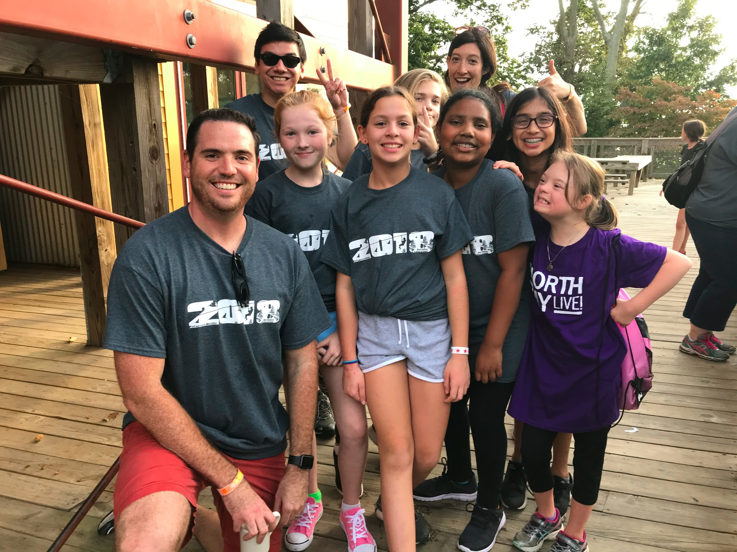
Save the Date:
Outdoor Education -
October 23-25th
Luggage Drop Off Oct 22nd
Approximate Cost +/- $170
Chaperones needed
(you won’t regret it)
Take care of health/medical forms in advance
Parent info night in September before Back to School Night
Notes:
Mike

Slide 37
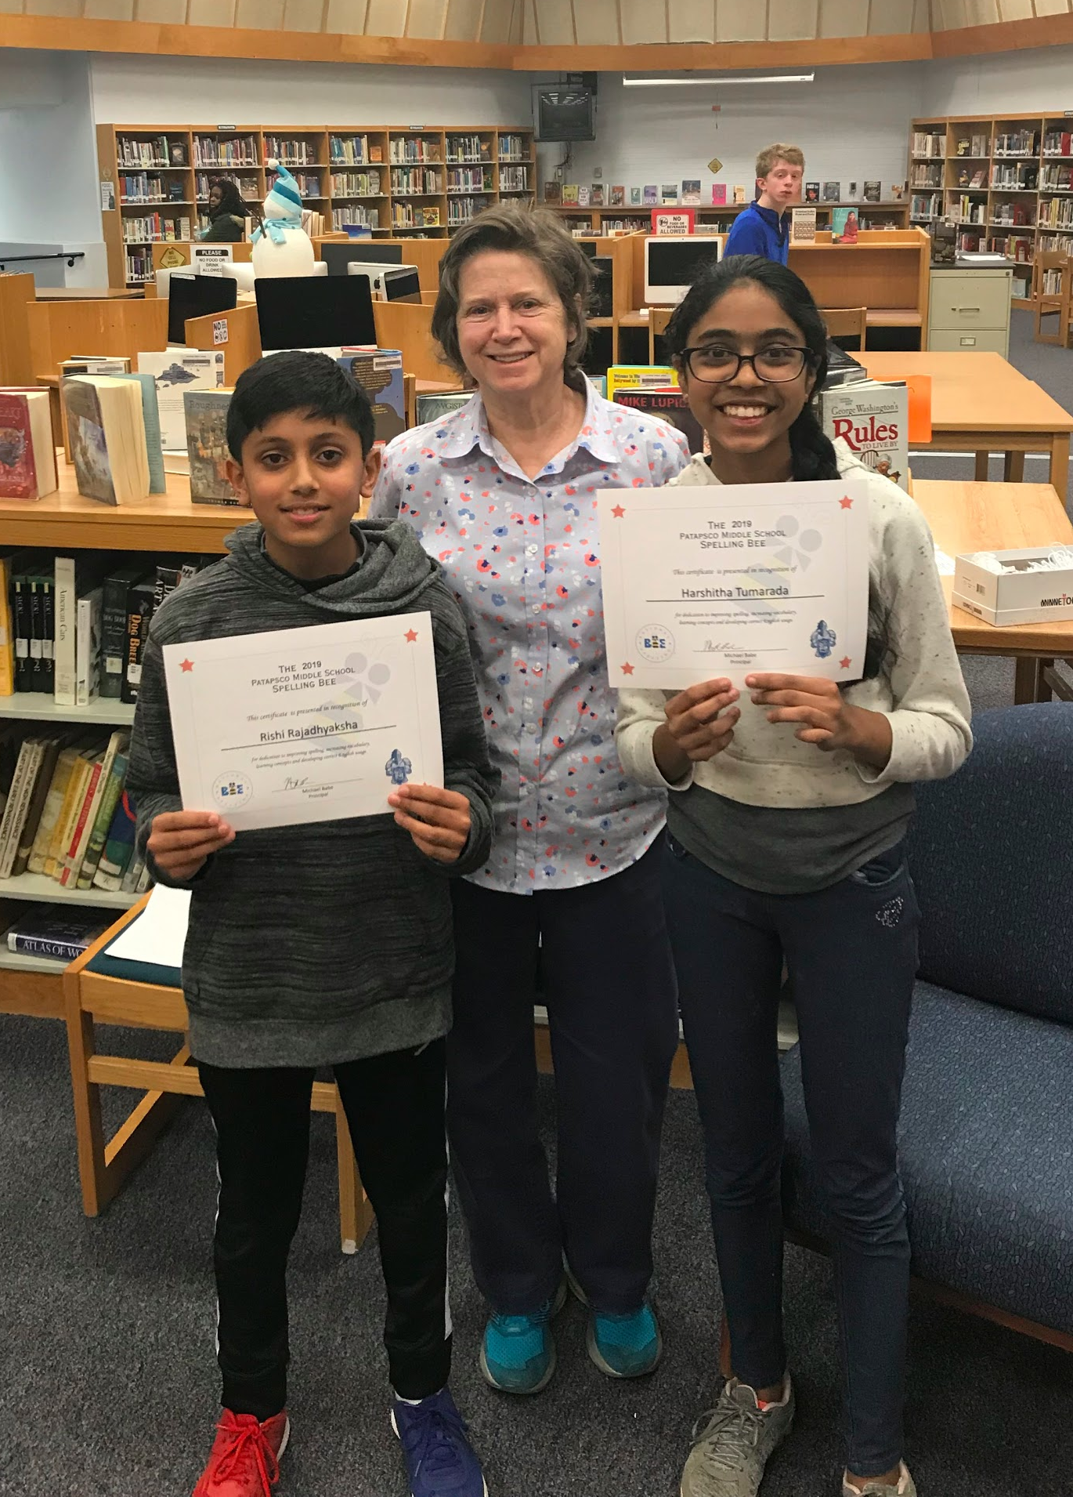
The earlier a student develops important academically related behaviors, the more likely these behaviors are to become a habit.
Source: The Forgotten Middle: Ensuring that All Students Are On Target For College and Career Readiness Before High School

Slide 38
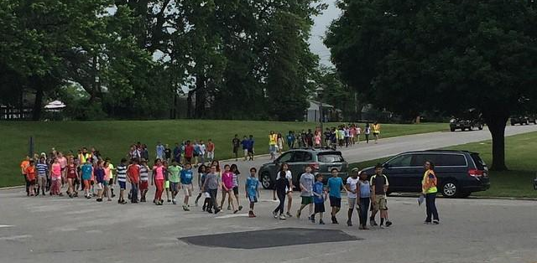
5th Grade Middle School Visit
May 21, 2019

